Slide 1
EU Open Science
coordination meeting
21.10.2019, Helsinki
Welcome address
Professor Riitta Maijala,
Vice President for Research
Academy of Finland

Slide 2
Openness
as the
fundamental
princple
Grand
challenges
Citizens
Increase in
data produced and used
number of publications
number of researchers
Technological
developments
Diversity of
scientific
community
Recruitments
and
evaluations
Ways of
conducting
research

Slide 3
Finnish Open Science and Research Initiative (ATT) 2014-2017
The purpose of the Initiative was to promote science and research by making them more open and increase their social impact by improving the management and use of research-generated information.
Roadmap of Open Science and Research
Examples of outputs
The Open Science and Research Handbook
Production of training material and sessions
Development of services such as IDA-research data storage service and the databank of Finnish research infrastructures
Evaluation of Openness in the Activities of Research Institutions and Research Funding Organizations

Slide 4
External evaluation in 2016 The impact of the Finnish Open Science and Research Initiative (ATT)
All in all, the ATT Initiative has been a dynamic, multi-actor and multi-level facilitator of the transformation towards open science.
The current collaborative and practical approach has been praised.
Impact of the ATT initiative
Interest level: Strong impact
Strategic level: Affected on the strategies or policies of the target groups
Operational level: Weak impact
Open Science in Finland now coordinated by The Federation of Finnish Learned Socities

Slide 5
Why international collaboration and discussion is essential?
Science is international by nature
It develops at the same time in many different places
No country, organization or community can make a sustainable approch for open science in isolation
Currently it is not easy to navigate in the field of open science
We need real time active coordination and learning at the international, national and local level as well as between them

Slide 6
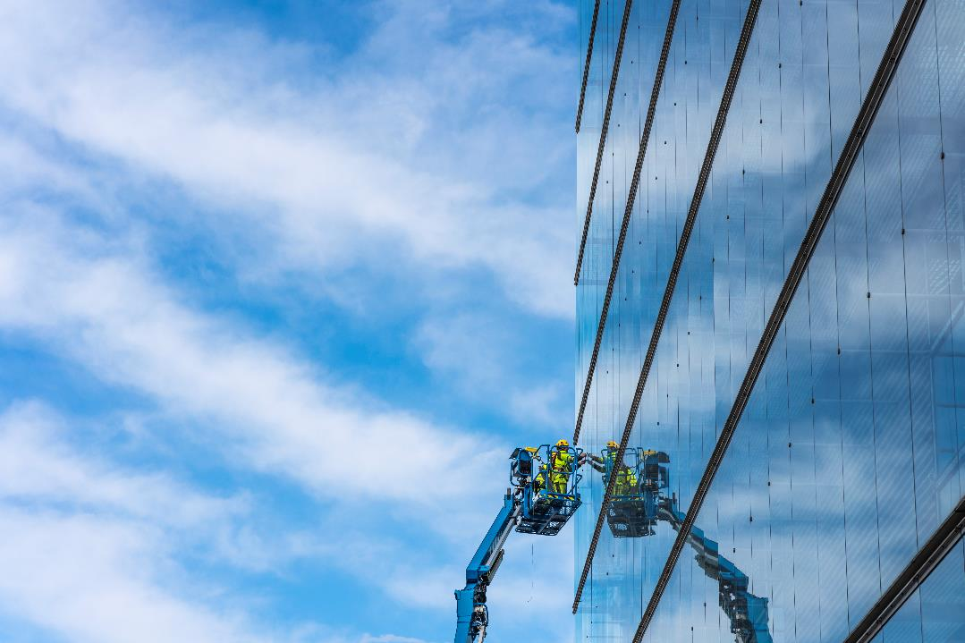
Openness is essential for the
renewal, quality and impact
of science and research
Science is a shared knowledge
Openness allows to build on the shoulders of the giants
Limited access to already existing scientific knowledge limits the possibility for breakthroughs
Openness increases the access
Reliability of the building blocks for scientific work is essential
Openness supports reproducability
Trust is essential for the interest to use the scientific knowledge
Openness helps the outsiders to see what scientific community is doing and how
©Pasi Markkanen, Suomen Kuvapankki, DSC4284.jpg

Slide 7
“Open scholarship is a challenge and opportunity
for the whole research community.”*
*Open science coordination in Finland

