Slide 1


Coordinate the coordinators
The need for a
Network of Open Science Coordination
Marin Dacos - Open Science Advisor
to the Director-General for Research and Innovation
Ministry of Higher Educaation, Research and Innovation
"Groups" by Jeremy Cowart
CC BY-NC-ND 4.0

Slide 2

Context : Amsterdam call for action on open science - 2016
Notes:
contradictory injunctions imposed on researchers with respect to this issue, between making data available and keeping them under wraps

Slide 3

National plan for open science (NL)
The National Plan Open Science concentrates on three key areas:
Promoting open access to scientific publications.
Promoting optimal use and reuse of research data.
Adapting evaluation and award systems to bring them into line with the objectives of open science (reward systems).
Notes:
The National Plan Open Science concentrates on three key areas:
Promoting open access to scientific publications.
Promoting optimal use and reuse of research data.
Adapting evaluation and award systems to bring them into line with the objectives of open science (reward systems).

Slide 4


Slide 5
Digital Republic Law
October 2016
1. Publications : a new right for authors
Article 30 : When a research is 50% publicly funded, the author retains the right to publish in open repositories 6 (STM) to 12 months (HSS) after publication.
2. Data : a new duty for universities and research performing organizations
Article 6 : open data should be the default for all publicly funded data, including research.

Slide 6
First commitment: generalize open access to publications

Slide 7

Roadmap
1. Make open access mandatory for projects
  when publishing articles and books resulting from government-funded calls for projects. Example : ANR.
Create a National Open Science fund to develop bibliodiversity.
Starting at 3,1M€ in 2019 with 1M€ coming from Elsevier savings.
3. Support the HAL national open repository
And simplify the publication filing procedures for researchers who publish through open access platforms around the world (ArXiv, Plos, …).

Slide 8
Open Access in general and Plan S in particular : one size does not fits all
We recommand the co-existence of different roads:
  in an open archive that is permanent and recognized by the various scientific communities (“green mode”);
  open access publishing based on fair, transparent, and economically sustainable business models
    With publicatin fees (“gold APC mode”).
    Publication where neither the author nor the reader pays (“diamond” mode);

Slide 9


Slide 10
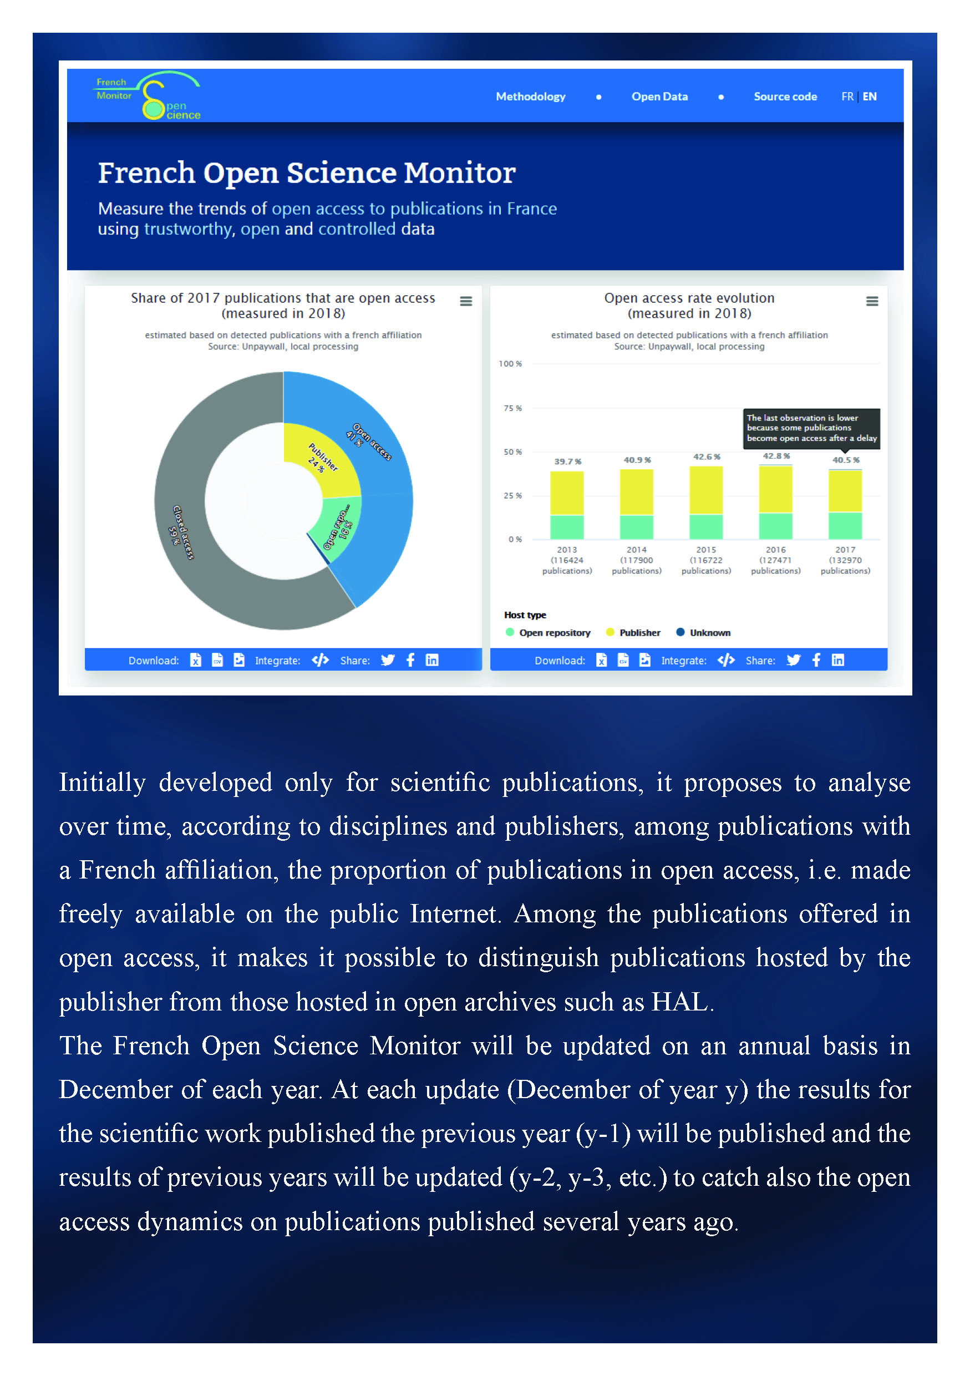
41%
open access

Slide 11
What would be the added value of NOSC ?
Network of open science coordination

Slide 12
Some possible examples

Slide 13
National Open Science Fund
  France :
          €
  25 countries* :
          €€€€€
          €€€€€
          €€€€€
          €€€€€
          €€€€€
  * Size of ERAC : 40 countries

Slide 14
Sustainability Coalition for Open Science Services (SCOSS)
  France :
          €
  25 countries* :
          €€€€€
          €€€€€
          €€€€€
          €€€€€
          €€€€€
  * Size of ERAC : 40 countries

Slide 15
National Open Science Monitor
Implement similar methodologies at
  local,
  national,
  and european levels
Share data, code and methodology to upgrade
Extend this approach to
  Open and FAIR data
  Open source
  Citizen science
  Training to open science
  etc.

Slide 16
Iniative for OpenCitations – I4OC
  Fill the gaps with national data
  Help negociations with publishers
  Etc.

Slide 17
Second commitment: structure research data and (when possible) make it available through open access
“Research data are the raw materials of knowledge. Sharing them means opening new scientific perspectives.”

Slide 18
Roadmap
4. Make open access dissemination mandatory for research data resulting from government-funded projects.
5. Create the position of Chief Research Data Officer and the corresponding network within the research institutions.
6. Promote the adoption of an Open Data policy for articles published by researchers.

Slide 19
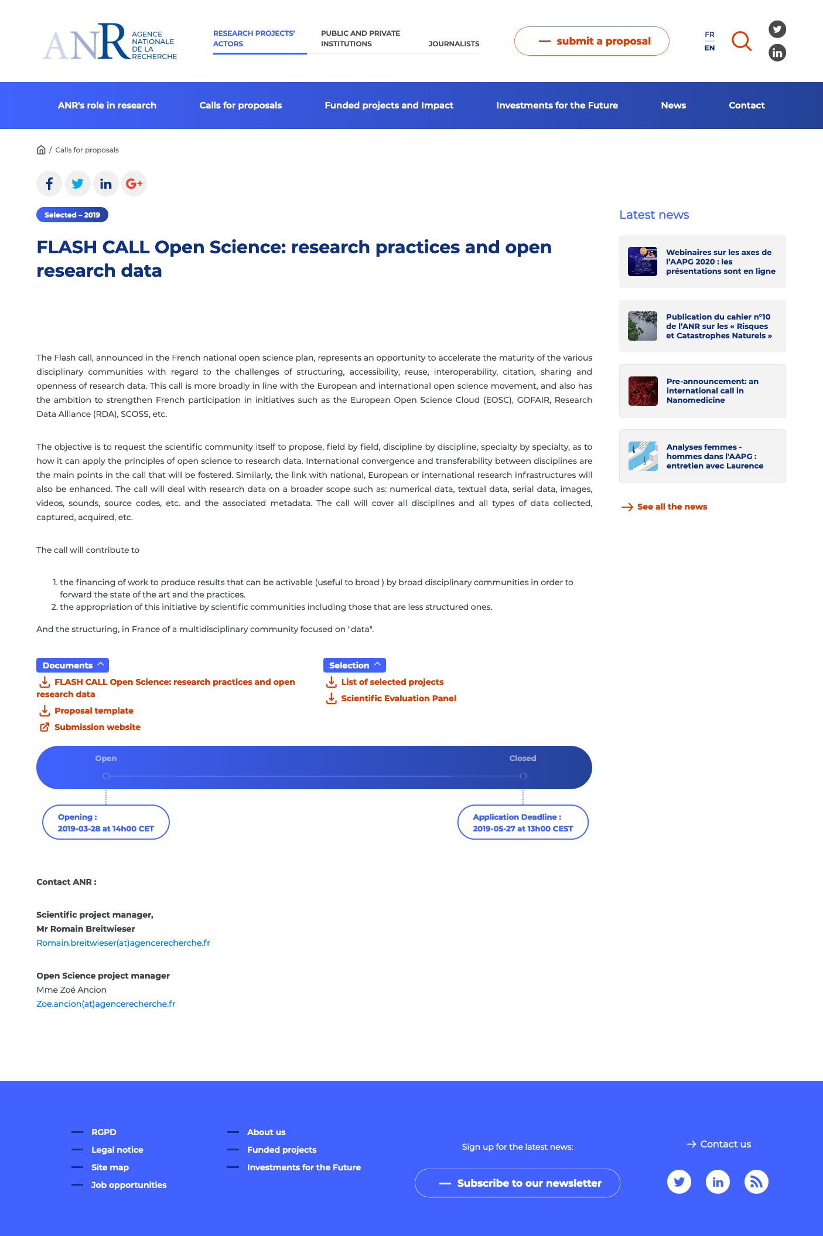
ANR Flash call for open science and research data (2019)
2,3M€
25 projects selected

Slide 20

French Open Science Committee
Comité pour la science ouverte
President : Bernard Larrouturou
Director-General for Research and Innovation

Slide 21
French Open Science Committee
Comité pour la science ouverte
A - Open Science
Steering committee
C- Open Science working groups
D - Online Open Science Forum
B - Open science Executive board
Director general for research and innovation + Presidents of major resarch performing organisations + Presidents of major universities
14 people
24 people
Representative from all organisations in the board + experts coming from the permanent groups.
80 people
4 groups : Publications, Research data, Skills, European and International coordination. Special interest groups as often as needed.
Public call for interest. 50% researchers. 41% STM. 48% universities. 55% women.
300 people

Slide 22
Missions of the French Open Science Committee
A – Open Science Steering Committee
Make decisions about
  National Open Science Fund,
  Funding mechanisms,
  Policies and priorities.
B – Executive board
Coordinate institutions in order to implement the National Open Science Plan.
C – Working Groups
Recommandations, user guides, advices, best practices, concerning the different topics of the National Open Science Plan.
D – Open Science Forum
  Feedbacks about the documents produced by the groups
  Questions and ideas coming from the research communities.

Slide 23
What would be the added value of NOSC ?
Network of open science coordination

Slide 24

Interconnect the National Open Science Committees

Slide 25
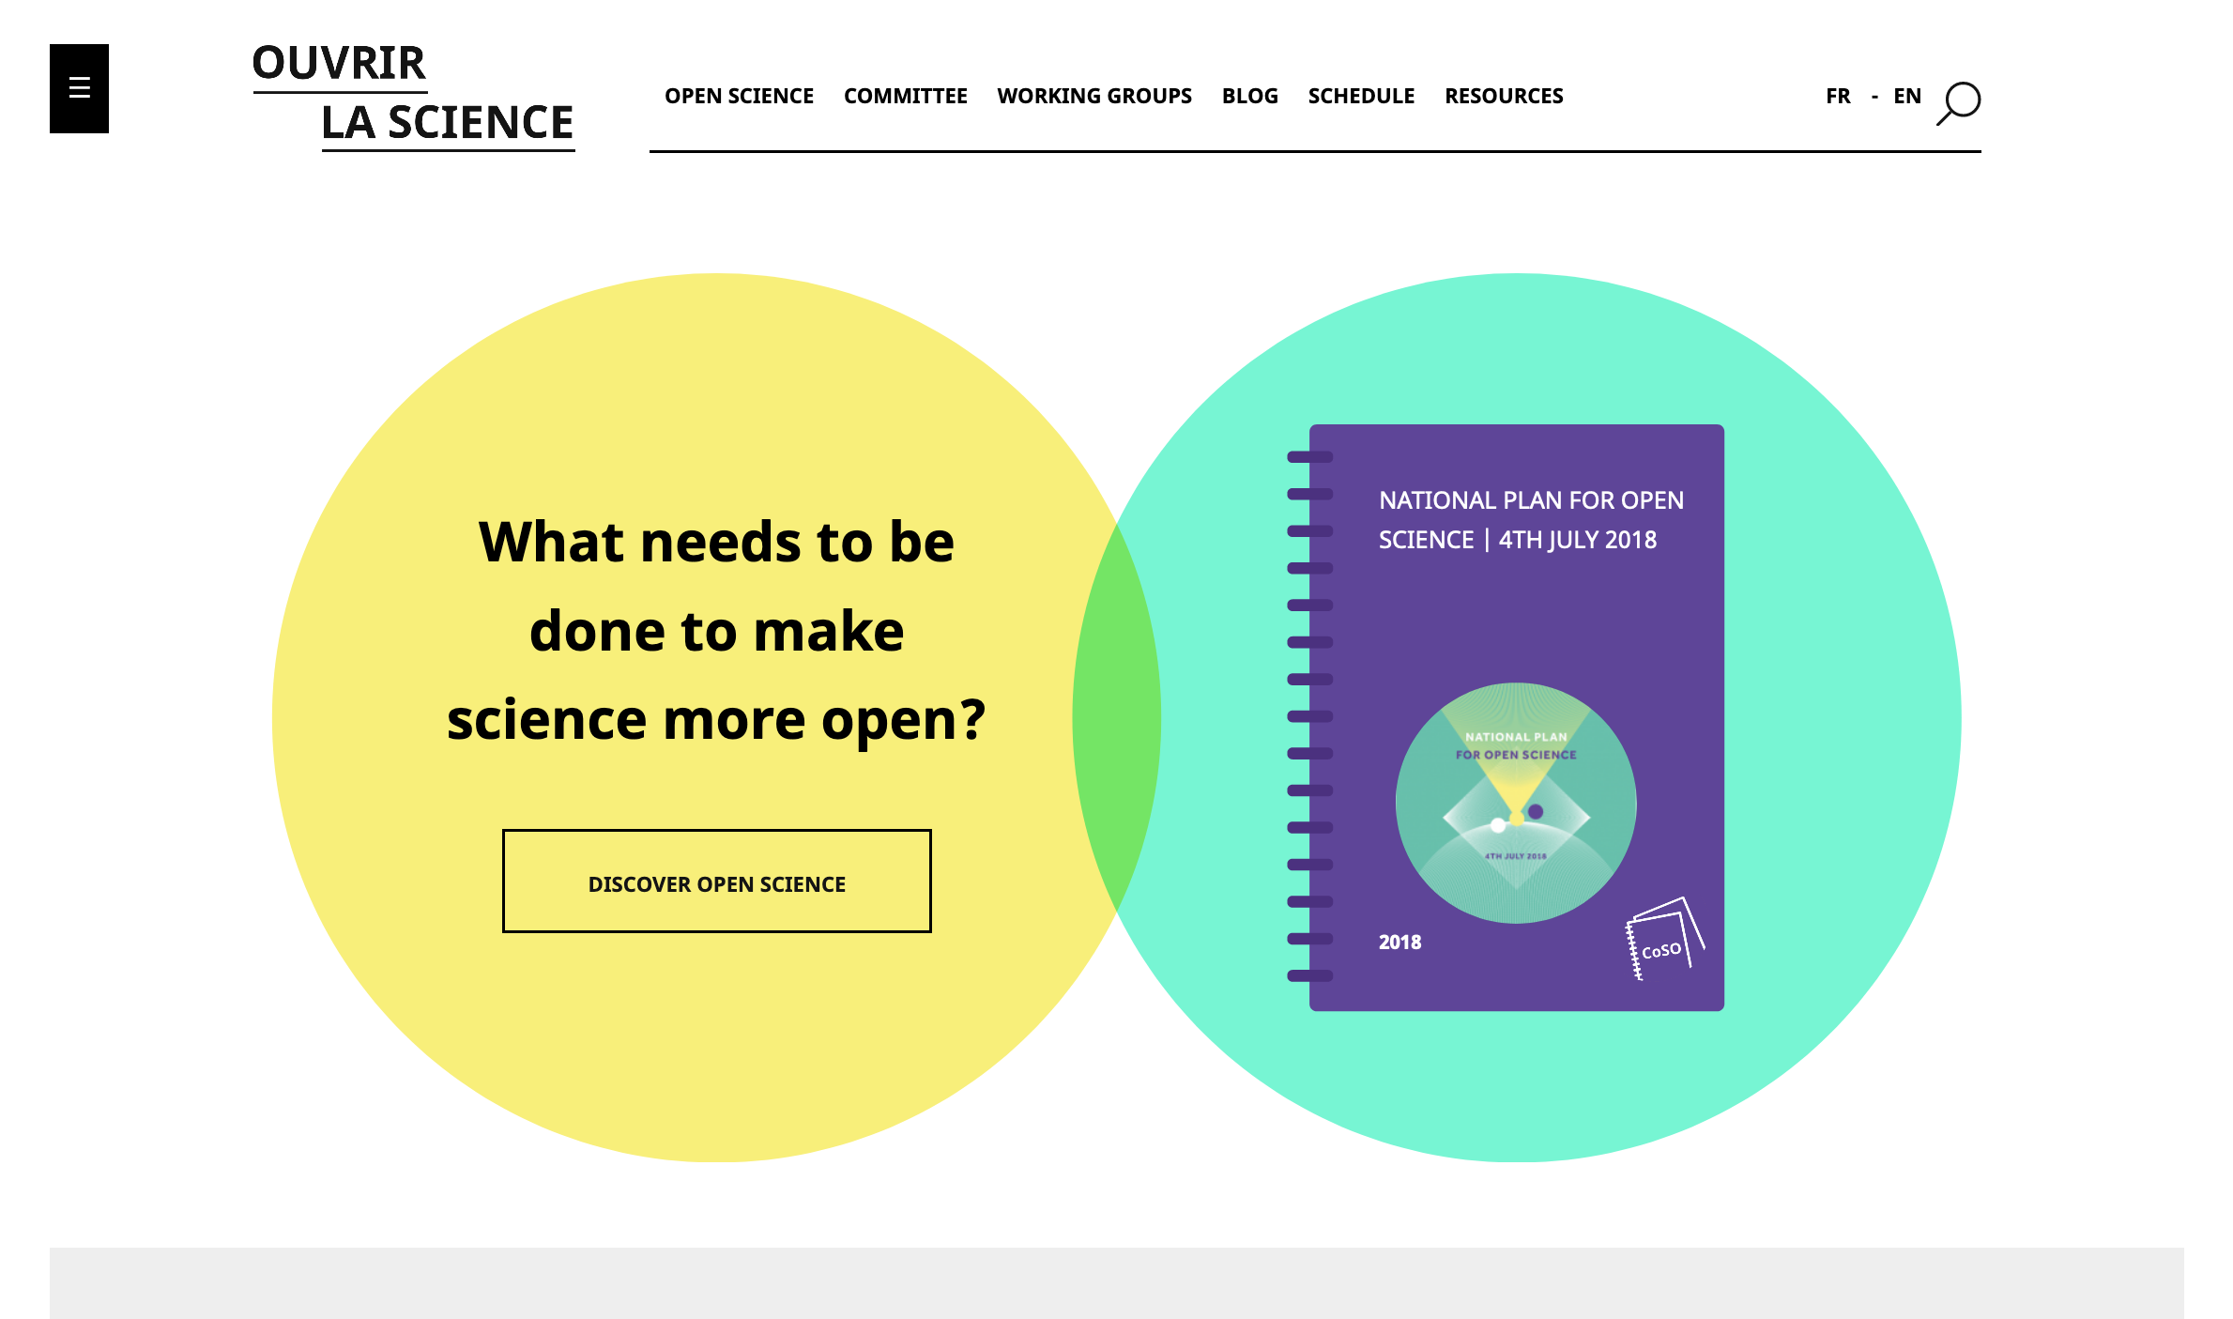
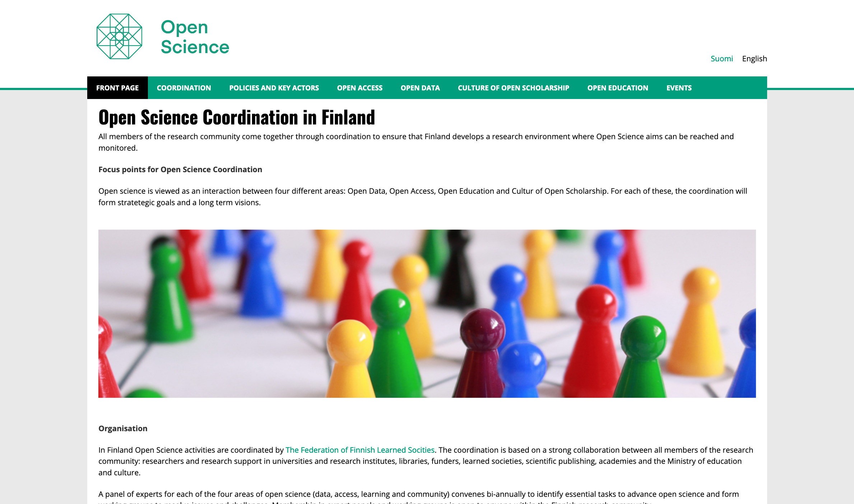
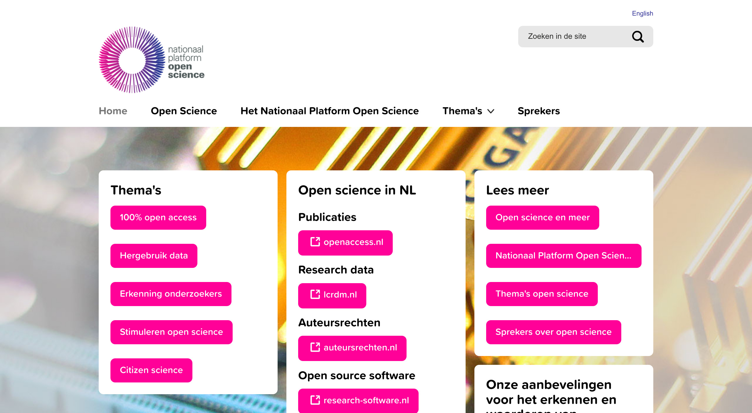
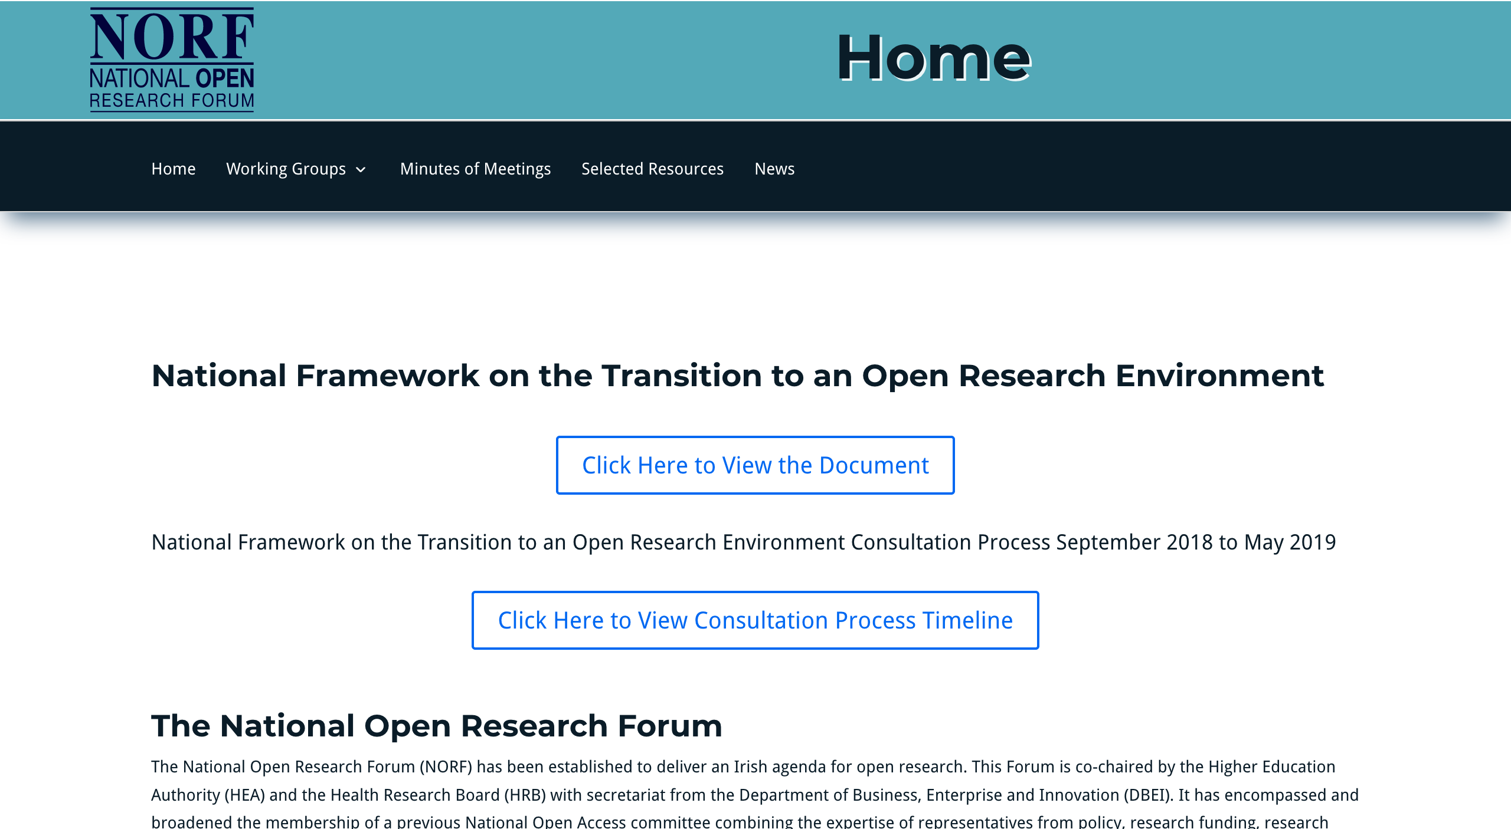
Cooperate for a better communication about Open Science
https://www.ouvrirlascience.fr/
https://www.openscience.nl/
https://www.openscience.fi/
http://norf-ireland.net/
Etc.

Slide 26
Help the National Chief Research Data Officers
Help each country to appoint a Chief Research Data Officers at national level
Help to create a coordination of CRDO

Slide 27
ANR Flash call for open science and research data
Why only a national call in 2020 ?
There is room for a multilateral call !

Slide 28
Third commitment: be part of a sustainable European and international open science dynamic
“France is committed to making open science a normal, everyday practice for researchers”

Slide 29
Roadmap
7. Develop open science skills, especially in postgraduate schools.
8. Encourage universities and research performing organisations to adopt open science policies.
9. Actively contribute to structuring European Open Science landscape

Slide 30
What would be the added value of NOSC ?
Network of open science coordination

Slide 31

Share and translate training material

Slide 32
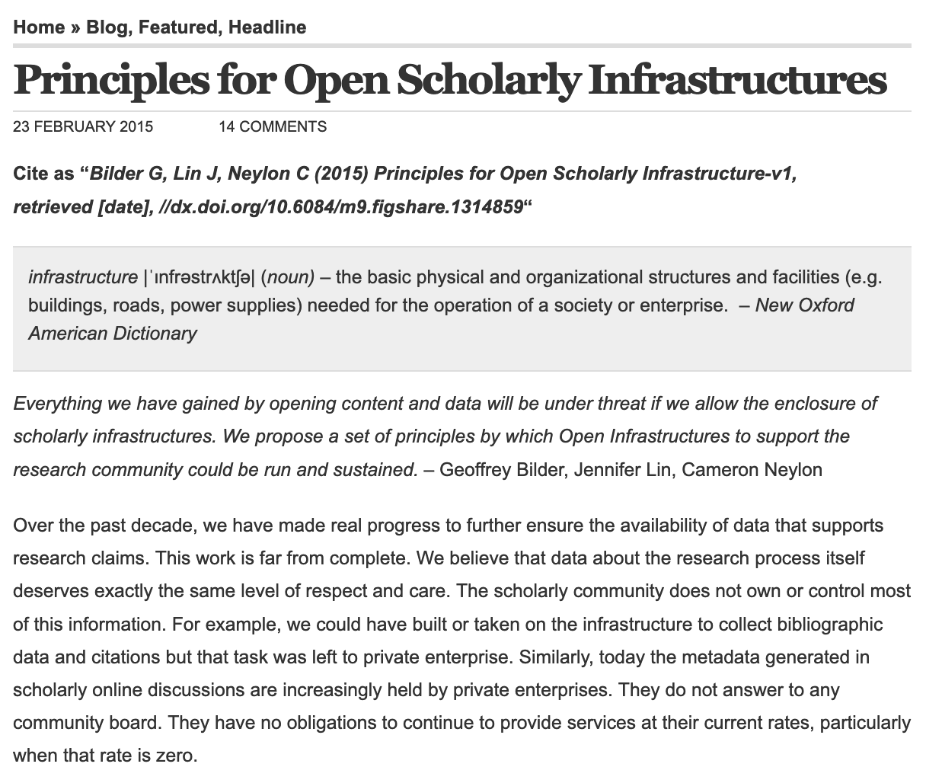
Accelerate the writing, spreading and implementation of best practices

Slide 33




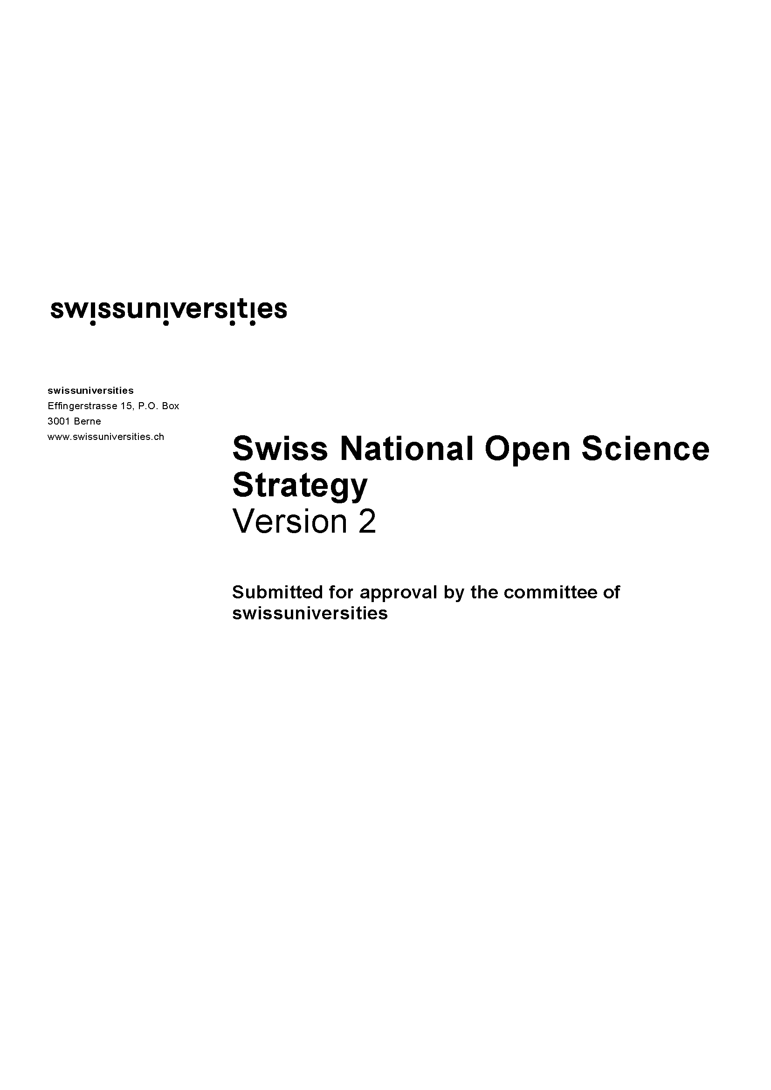

Help each others to write, implement and update our national plans

Slide 34
Contribute to the EU coordination effort and initiatives : open science policy, EOSC, OSM, etc.

Slide 35
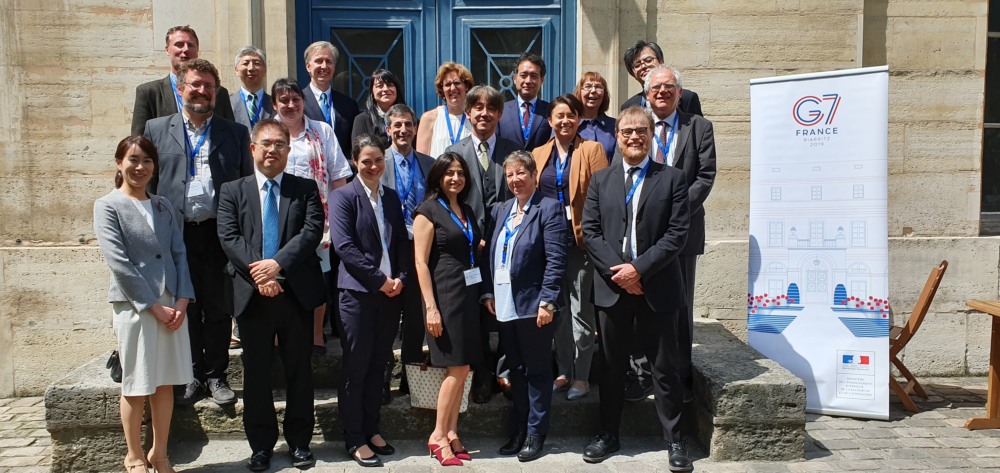
Embed our policies and views into WorldWide policies, such as OGP, G7, OECD, UNESCO…

Slide 36

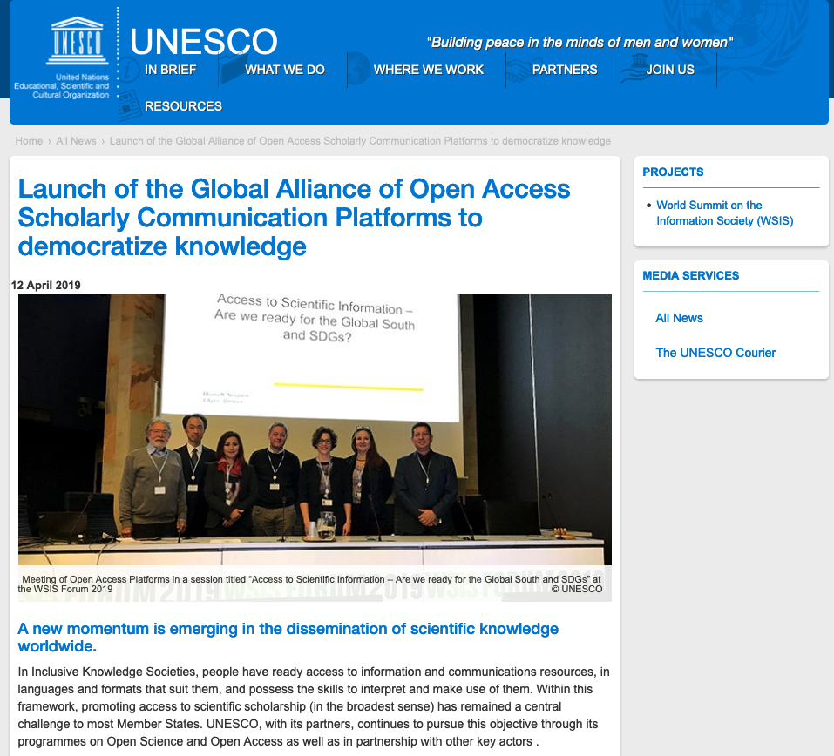
Embed our policies and views into WorldWide policies, such as OGP, G7, OECD, UNESCO…

Slide 37
Promote the idea of creating an Intergovernmental Panel of Experts on Open Science (IPOS)
IPCC - Intergovernmental Panel on Climate Change as a model
We need to consolidate knowledge on open science : on how-to, on impact and on the economy of open science.

Slide 38
Do not forget…
« Principles for Open Scholarly Infrastructures »
https://figshare.com/articles/Principles_for_Open_Scholarly_Infrastructures_v1/1314859

Slide 39

Help to mutualise open science services and infrastructures

Slide 40
At the end…
What would be the added value of NOSC ?
Network of open science coordination

Slide 41
Coordinate the coordinators !
"Groups" by Jeremy Cowart is licensed under CC BY-NC-ND 4.0

Slide 42
Thank you !
marin.dacos@recherche.gouv.fr
Twitter : @marindacos (French)
@openmarin (English)

