Slide 1
National Open Research coordination in Ireland
Dr Patricia Clarke, Health Research Board Ireland
Co-Chair, National Open Research Forum
Notes:
Give you an insight into how we are approaching the Open Research agenda within the National Open Research Forum.
- explain our national OS coordination under questions Why, What and How
Positioning NORF as an initiative that pre-dates Plan-S , that is positioned at a broader national level, and whose intention is that of developing and addressing common objectives towards supporting a better national research environment.
How and what we have been doing in NORF
National Statement – intention, consultation and bring to 1 March 2019 I2020 meeting for sign-off
NORF agenda broader that OA publications, but this is one key interlinked aspect
NORF approach to Open Access to publications ensures a consistency across all Irish research disciplines and funding streams (e.g. applies to anyone in receipt of core funding).
Plan-S enriching discussion – need to be clear on where the National Statement is aligned, and to gain an understanding of the opportunities and concerns with the key issues raised in Plan-S implementation guidance.
NORF implementation and Plan-S implementation should be one and the same, e.g. monitoring etc. Plan-S and NORF complement and enrich each other and, at a practical level, will require a lot of the same supports, investment and coordination efforts.

Slide 2
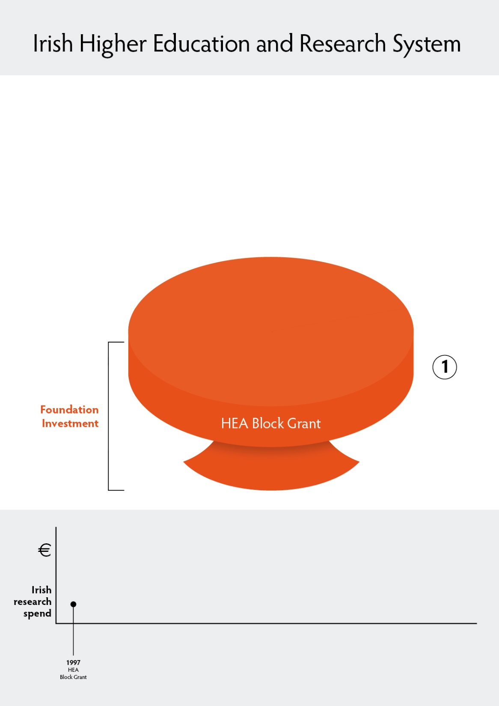
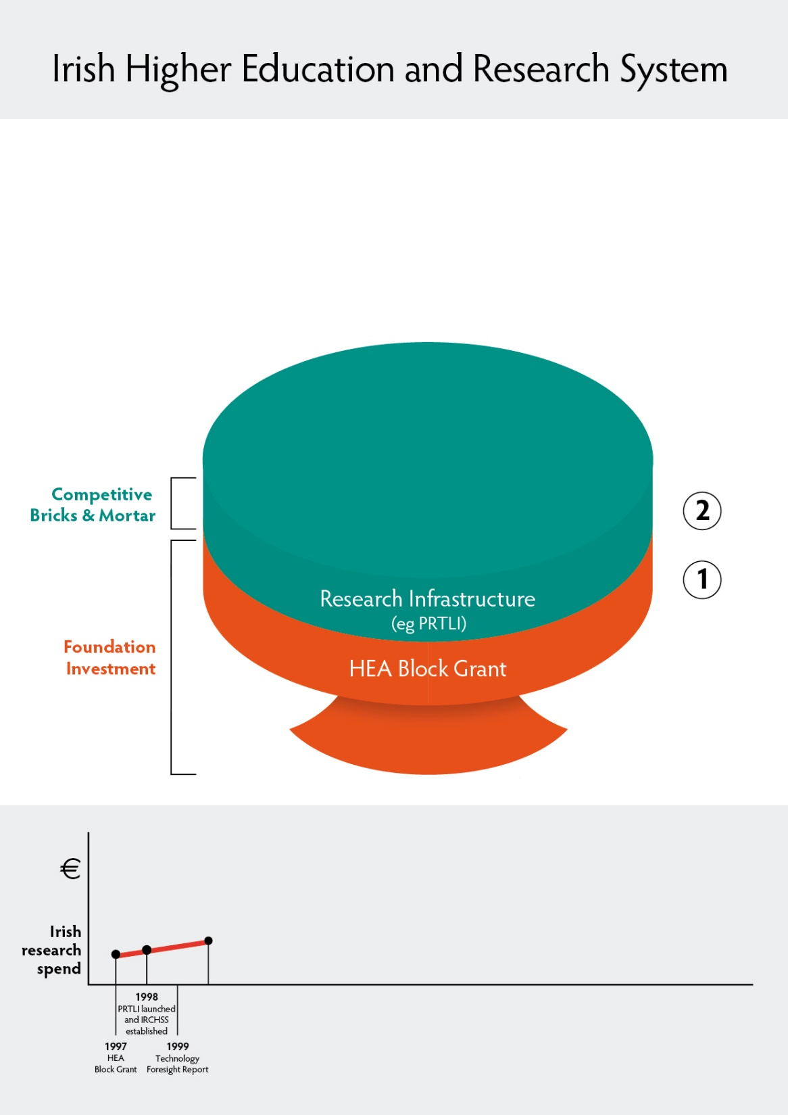
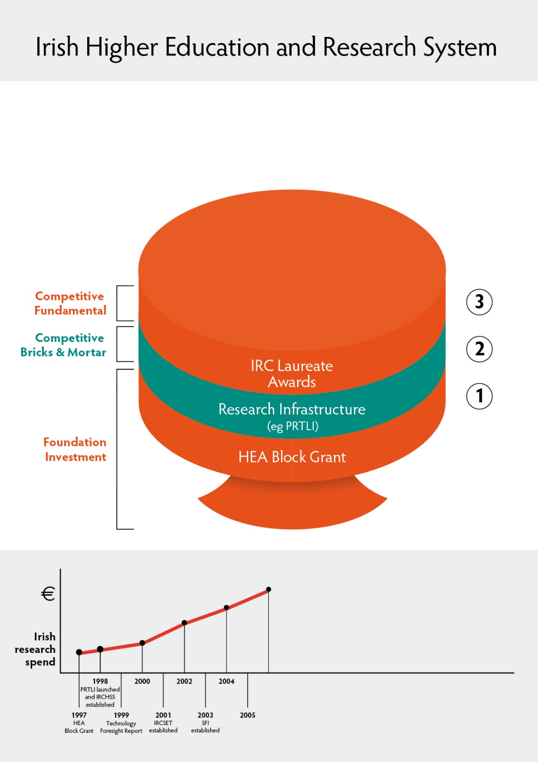
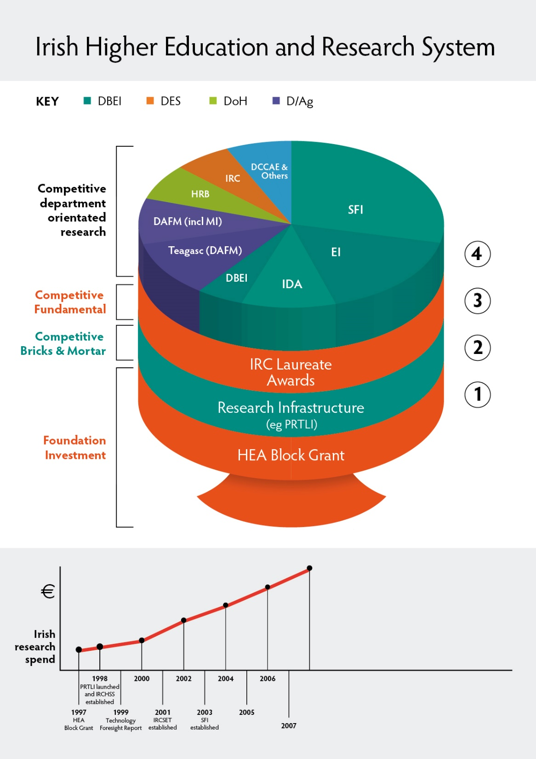
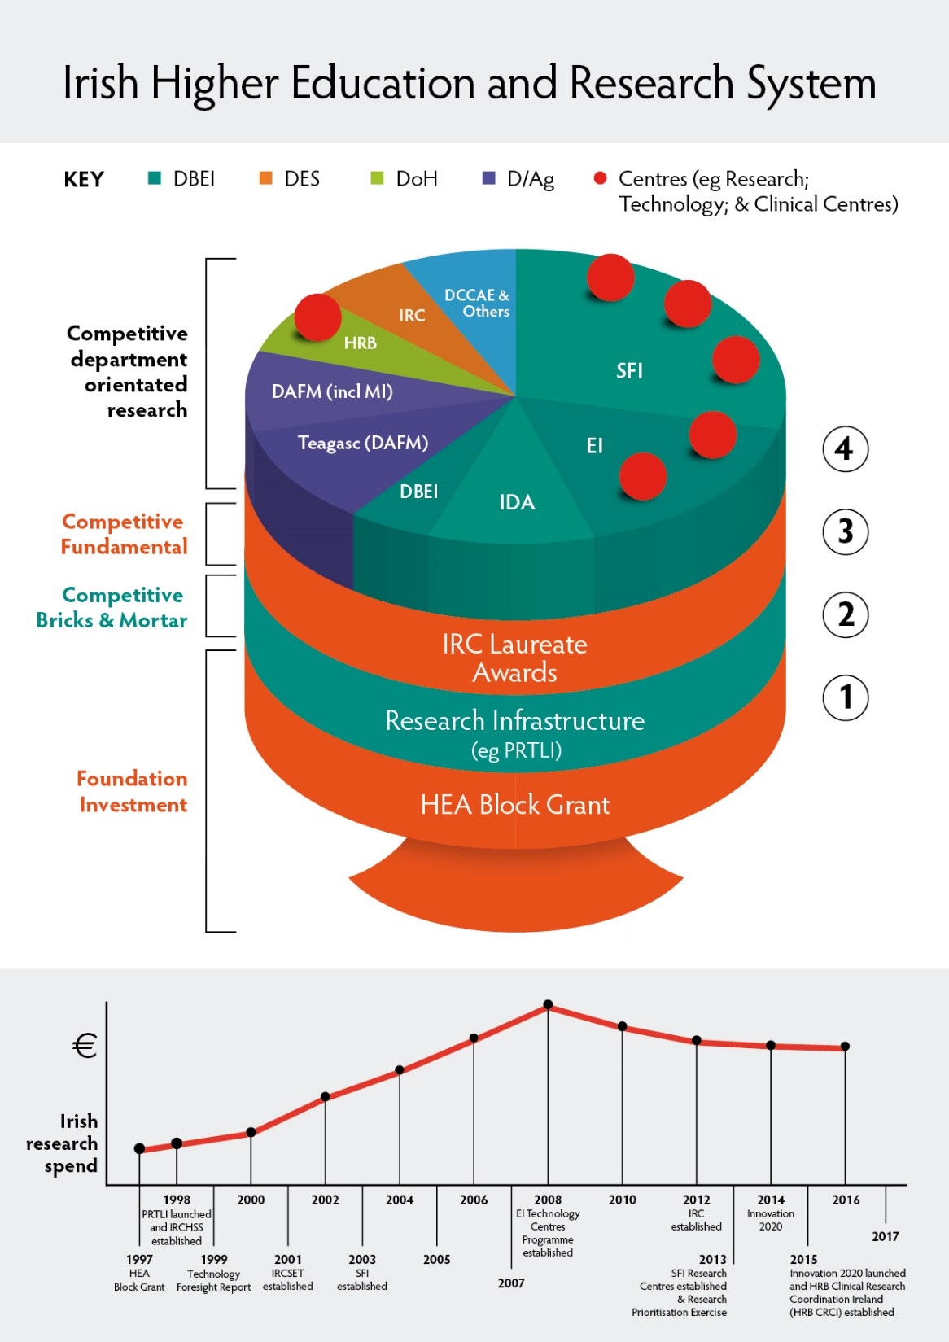
Built up research system over last 20 years
What Now?
Respond to the changing research environment
Open Research
Build stronger system foundations

Slide 3
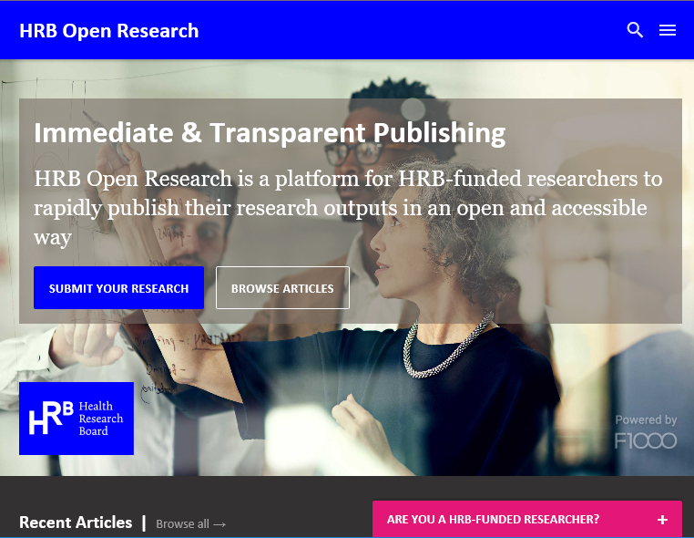
Research Infrastructures
Pay to publish papers
Pay to
make them open access
Pay to
read them
Pay to analyse who reads them
HRB Open Research Publishing Platform
National
Open Research Forum
Irish Research eLibrary
Bibliometric Analysis Tools

Slide 4
International Policy Context
2012 EU Recommendations on Access to and Preservation of Scientific Information
Horizon 2020 and Horizon Europe
Required Open Access and Open Data; European Open Science Cloud (EOSC); open data-driven science; use/experimentation of open science approaches (e.g. knowledge- or data- sharing, networks, platforms and hubs).
April 2016 European Cloud Initiative Communication
Seamless environment for access to data services, to build on and support OA and OS
May 2016 Council Conclusions
Support for OA publications, data re-use & data management initiatives. OA to be default by 2020
Stakeholders and expertise to shape policies
Open Science Policy Platform, Expert Groups on FAIR data, the Future of Scholarly Publishing, skills and rewards, new generation metrics, integrity
April 2018 EU Data Package
Revised 2018 Recommendations to include RDM and FAIR data, better data analytics, Text and Data Mining, realisation of the EOSC, skill and competencies, and incentives and rewards.
Revised Public Sector Initiative (PSI) Directive requiring national policies to facilitate re-use of research data resulting from public funding
October 2018 Plan-S
OA publications, copyright, no embargos, research assessment (DORA)

Slide 5
What is Open Science/ Open Research?
“Open Science represents a new approach to the scientific process based on cooperation work and new ways of diffusing knowledge by using digital technologies and new collaborative tools. The idea captures a systemic change to the way science and research have been carried out for the last fifty years: shifting from the standard practices of publishing research results in scientific publications towards sharing and using all available knowledge at an earlier stage in the research process”
(Open Innovation, Open Science, Open to the World – a Vision for Europe, European Commission, 2016)

Slide 6
National Open Research Forum (NORF) Phase 1 (March 2017- June 2019)
Co-chaired by Higher Education Authority and Health Research Board
Secretariat provided by Department of Business, Enterprise and Innovation
Support from Department of Education and Skills
Broad membership - policy, research funding, research performing, library sector and other key stakeholders
Working Group structures
Vision
Turning Words into Actions – A Vision for Open Research in Ireland
Open Access
National Open Access (to Publications) Principles Statement
Open Data
Research Data Principles
Research Infrastructure
Research Information Infrastructure Roadmap
Joint Statement of Principle on the adoption and use of ORCID and related persistent identifier infrastructure

Slide 7
Consultation and Plan-S consultation
Cork Institute of Technology (CIT), Nimbus Research Centre
Digital Repository of Ireland (DRI)
Dublin Institute of Technology (DIT) Technology University (TU) Dublin Open Research Group
Economic and Social Research Institute (ESRI)
Enterprise Ireland (EI)
Health Research Board (HRB)
International Association of STM Publishers (STM)
Irish Humanities Alliance (IHA)
Irish Research Council (IRC)
Irish Universities Association (IUA)
Irish Universities Association Librarians Group (IUA LG)
Maynooth University (MU) Research Committee
National Library of Ireland (NLI)
National University of Ireland Galway (NUIG)
National University of Ireland Galway (NUIG) Moore Institute
Royal College of Physicians (RCSI)
Royal Irish Academy (RIA)
Science Foundation Ireland (SFI)
SciPol Independent Consultancy
Teagasc
Teagasc CELUP Crop Research
Technological Higher Education Association (THEA)
Trinity College Dublin (TCD) DARIAH
Trinity College Dublin (TCD) Open Scholarship Taskforce
University College Cork (UCC)
University College Dublin (UCD)
Upsalla University

Slide 8
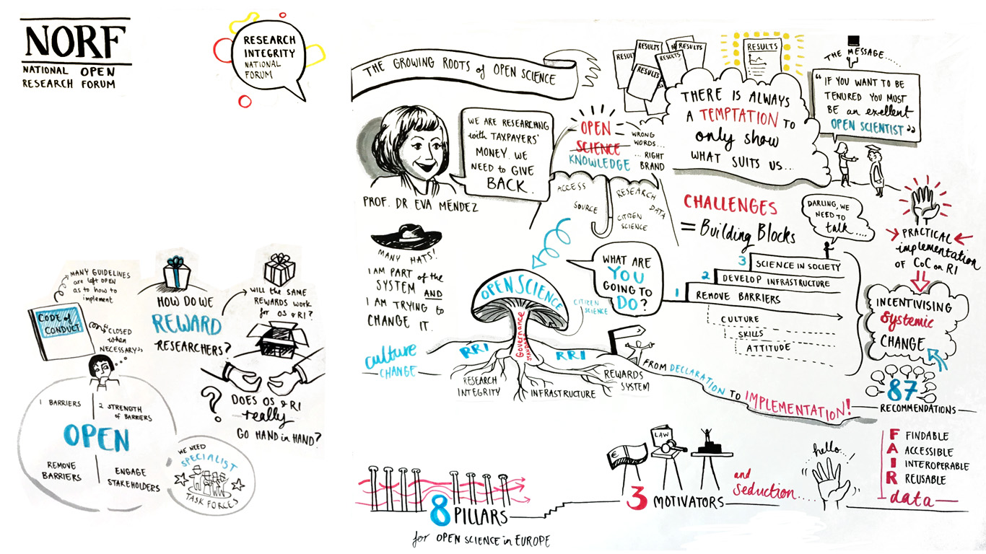
National Research Integrity Forum and National Open Research Forum “Responsible research in an open research environment” 8th March 2019
Workshop report available at: https://www.iua.ie/research-innovation/research-integrity/march-8th-2019-joint-workshop-by-the-nrif-and-the-national-open-research-forum/

Slide 9
July 2019

Slide 10
National Open Research Forum http://norf-ireland.net/
Enabling FAIR research data
Infrastructures for access to and for preservation of research
Skills and competences
Incentives and rewards
Open Access to research publications
July 2019: Ministerial Announcement with initial support
Departments: DAFM, DBEI, DES, DCCAE
Funders: HRB, HEA, SFI, IRC, EPA, Teagasc, SEAI
Universities: TU Dublin, UCC, RCSI, THEA, CIT
Infrastructures: CONUL, OpenAIRE Node, NLI, RDA Node, DRI

Slide 11
Key Points
Clearer and cleaner routes to OA publications, including publishing platforms;
Removing local archiving requirement, recognising the role of international repositories such as Europe PMC;
Commitment to develop national measurement of OA publication practices;
Moving towards ’no embargos’ for OA publications;
Clarifying intention nationally not to pay APCs for hybrid journals;
New national principles for research data in line FAIR data principles and research data management plans;
Commitment nationally to look at underpinning infrastructure needs such as global persistent identifiers and better use of metadata;
National consideration of skills and training needs for open research at all career levels;
National conversation on infrastructure needs (rather than institution by institution), especially for research data;
Systems-wide lens for ‘responsible metrics’ shifting from reliance on journal impact factor, in line DORA;
Consideration of system approach for rewards and incentives;
Funders to require OA at both grant evaluation stage and at contracts stage

Slide 12
What now?
NORF Phase 2
National coordinator role
Reconstituting NORF membership to focus on implementation
Deliver National Planning Exercise
National Action Plan - implementation
concrete objectives and indicators to measure progress
priorities for implementation, including the allocation of responsibilities
associated financial planning
Part-time post in IReL to drive national ORCID membership
multi-annual planning process
Testing the readiness of our infrastructure, our working processes and capacity to help open practices to grow and thrive.

Slide 13
Agreement on a common direction
Key Questions
Who has lead responsibility for Open Science in Ireland?
Does NORF have a mandate to enter into the proposed Phase II activities?
How can implementation be cultivated?
What resourcing potential exists and how can this be best realised?
Leave no-one behind
All public research (block grants)
Engage with researchers at every research career stage and representing all disciples
Respect, engage with, and support the research community in the broadest sense
Address disciplinary, professional, national and global concerns in the area of research.
Speed of transition
Acknowledge that some Funders and Research Performing Organisations may have additional specific requirements relating to open research which should also be observed.

Slide 14
“moving beyond the individual areas of open research to understand the complex relationships between them and the underpinning regulatory and legal environment”.
National
Action
Plan
Skills and Competencies
Incentives and rewards
OA publications
FAIR research data
Infrastructure/ Long term preservation
National Persistent Identifiers
“Open research requires system-thinking and a change in research culture and behaviour.”
“The conditions required for implementation need to be cultivated.”
“Whilst accountability may sit with one Department/ Agency the solution more often sits with a broader group.”
“need trust and mutual respect, a strong sense of collective responsibility, data to benchmark and to measure transformation”
Longer-term resourcing and capacity-building issues

Slide 15
Advocating for a national coordinated approach
National Open Research Forum (NORF) Phase 2
FAIR DMP pilot Phase 2: International review of DMPs
HRB national GDPR and national ethics roles (potential for synergies)
HRB policy on sharing and managing research data
? HRB Open Research and DMP publication
? Irish Funders national approach to DMPs (DCC platform)
? Member States National Coordination
National Framework for transitioning to open research published by Irish government
National Integrity Policy Statement
Phase II FAIR DMP pilot
HRB
Adopted Science Europe RDM guidelines
Funders Implementation Study
Secondary data analysis awards
DASSL data linkage PoC award
Panel Observers
HRB Open Research platform
HRB DORA signatory
HRB-HEI data stewards upskilling, Leiden
Phase I FAIR DMP pilot in HRB funding schemes
Collaboration with GIFSCO and ZonMW
National Open Research Forum (NORF)
Collaboration with GO-FAIR and DTL
Building awareness FAIR workshops
(Tools and Partnerships)
Open Science and Ireland
Conference
2016
2019
2020
2018
2017
National OA principles

