Slide 2
Supporting policies through open knowledge & open innovation
Philippe Duponteil, Director, JRC, European Commission
Laurea University, 21 october 2019

Slide 3
    European Commission’s JRC's Mission
"
As the science and knowledge service
of the European Commission, our mission is to support
EU policies with independent evidence
throughout the whole policy cycle
"

Slide 4
    European Commission JRC Role: facts & figures
€ 386 million Budget annually,
plus € 62 million earned income
6 locations in 5 Member States: Italy, Belgium, Germany, The Netherlands, Spain
Independent of private, commercial or national interests
Policy neutral:
has no policy agenda of its own
42 lаrge scale research facilities, more than 140 online databases
30% of activities in policy preparation, 70% in implementation
JRC
83% of core research staff
with PhD,
c3000 total staff
125 instances of support
to the EU policy-maker annually
More than 100 economic,
bio-physical and nuclear models
Over 1,400
scientific publications per year
Notes:
JRC facts & figures → all info in one slide (select which slide you prefer 1 or 2)
Context of what JRC does and offers:
Fully policy-relevant and world class knowledge production
Priorities driven knowledge and competence management
One JRC – anticipating emerging issues,
understanding complexities and bridging silos
Addressing challenges of research
(information deluge, multidisciplinarity,
integrity, reproducibility)

Slide 5
    JRC Scientific Excellence
    1400 publications per year, open access
    40-50% of JRC publications belong to
    the top 25% most cited publications
    Up to 23% belong to the top 10%
    most cited publications
    Up to 3% belong to the top 1%
    most cited publications
Rapport icon
Notes:
On publications:
1400 publications per annum – all open access (eg in open access journals for peer-reviewed, published on EU Science Hub if JRC own publication

Slide 6
    JRC Scientific Excellence

Slide 7

Complexity: the meta-problem of our age
© pixelrobot - Fotolia
Notes:
Those of us working at the evidence – policy interface are confronted with 3 types of complexity:
Complexity of knowledge
Complexity of political problems – wicked problems
Complexity of the relationship between evidence and policy
Complexity is the meta-problem of our age.

Slide 8

Super-abundance of knowledge
© Andrea Izzotti - Fotolia
Notes:
Why such a complexity: first, Super-abundance of knowledge
There is good news and bad news. The good news is that we have never known so much about ourselves, our planet and our society.
According to the University of Ottawa, in 2009 we passed the 50 million mark in terms of the total number of science papers published since 1665, and approximately 2.5-3.0 million new scientific papers are published each year. As of 2014 there were approximately 28,100 active scholarly peer-reviewed journals.
This super abundance is also a curse. As William Davies said (2016): "The problem is the oversupply of facts in the 21st century: There are too many sources, too many methods, with varying levels of credibility, depending on who funded a given study and how the eye-catching number was selected."
Note: William Davies - author of the "The Happiness Industry" and The New York Times contributor. https://www.nytimes.com/2016/08/24/opinion/campaign-stops/the-age-of-post-truth-politics.html?_r=0

Slide 9
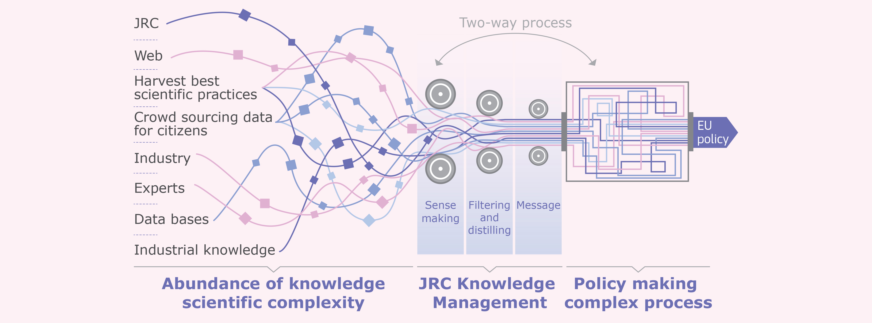
    Dealing with the information overload
Notes:
Dealing with the information overload
Today we have access to a unique vast amount of information
The information comes from many sources from crowd sourcing to universities and industry to individual experts
Within the European Commission there is a need/wish to manage this information, to separate the truth from the lies, the reality from the “alternative facts”
The added value of the JRC is to perform this task through our expertise and the development of Knowledge Management procedures. Including sense making / filtering / visualisation of data
Further it should be noted that the process is 2-way and dynamic both in the information and policy making domains

Slide 10
Scientific Networks
Open Knowledge at JRC
Centre for Advanced Studies
JRC Living Labs
Open Access to
Research
Infrastructures
JRC Knowledge and Competence Centres
Citizen science
JRC Academy
Knowledge for Policy platform
Notes:
Dealing with open access to information
Some of the measures we have put in place at the JRC to help us manage and share knowledge better –
The forthcoming JRC Academy is where we are grouping all the material that the JRC uses in courses and workshops
We also have a dedicated programme to open access to our physical infrastructures and testing facilities
38 accessible infrastructures – currently 87 institutions from 24 countries participating. Details available on our Science Hub.
We are increasingly focusing on citizen science and engagement – these range from apps tracking invasive alien species to a more recent initiative on 'Science for Cities' (launched in spring 2019) a programme where a number of cities across Europe are piloting dedicated projects.
I'm going to give a little more detail on three areas: JRC Knowledge and Competence Centres, Knowledge for Policy (K4P) Platform and our latest 'baby' – JRC Living Labs.

Slide 11
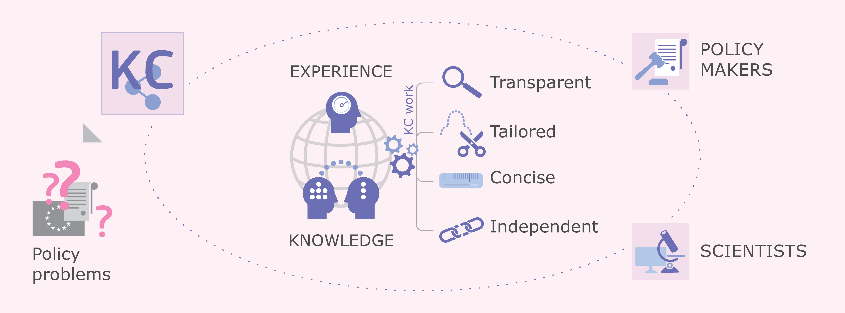
Open Knowledge - Knowledge Centres
Notes:
Knowledge Centres are virtual entities, bringing together experts and knowledge from different locations inside and outside the European Commission.
Their objective is to inform policy-makers in a transparent, tailored and concise manner about the status and findings of the latest scientific evidence.

Slide 12
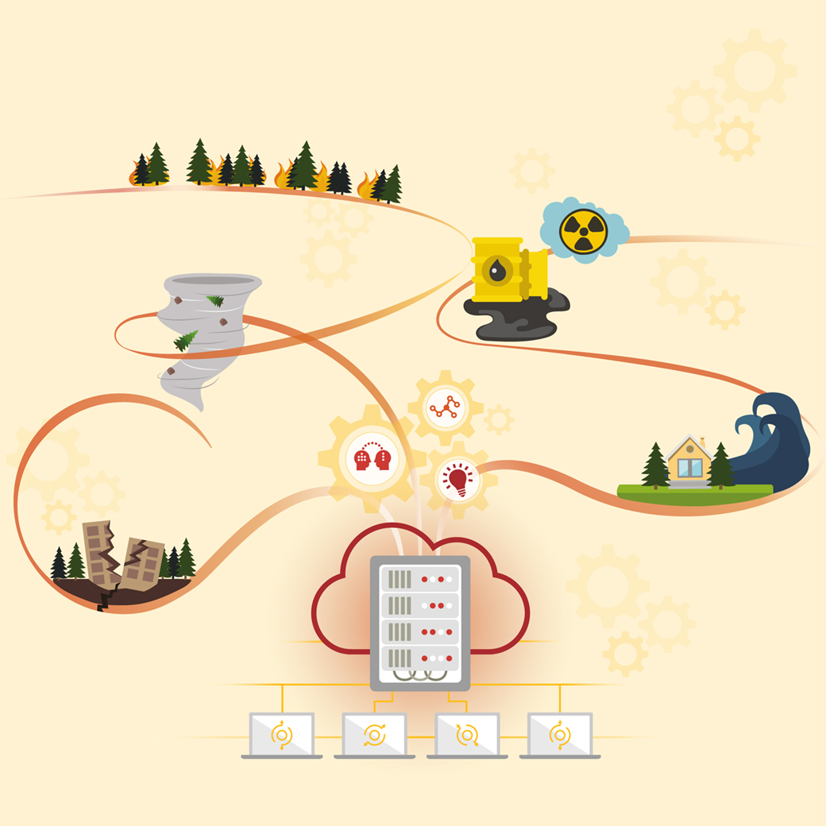


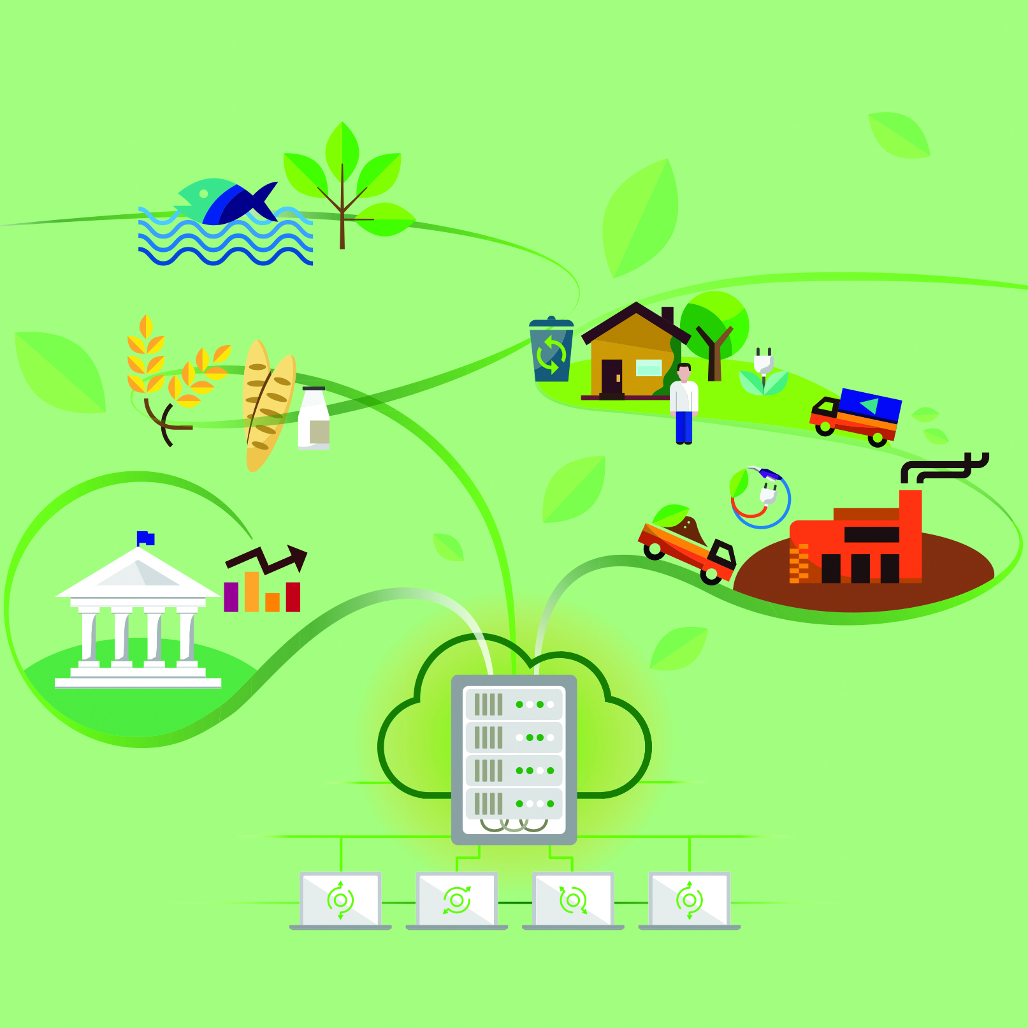
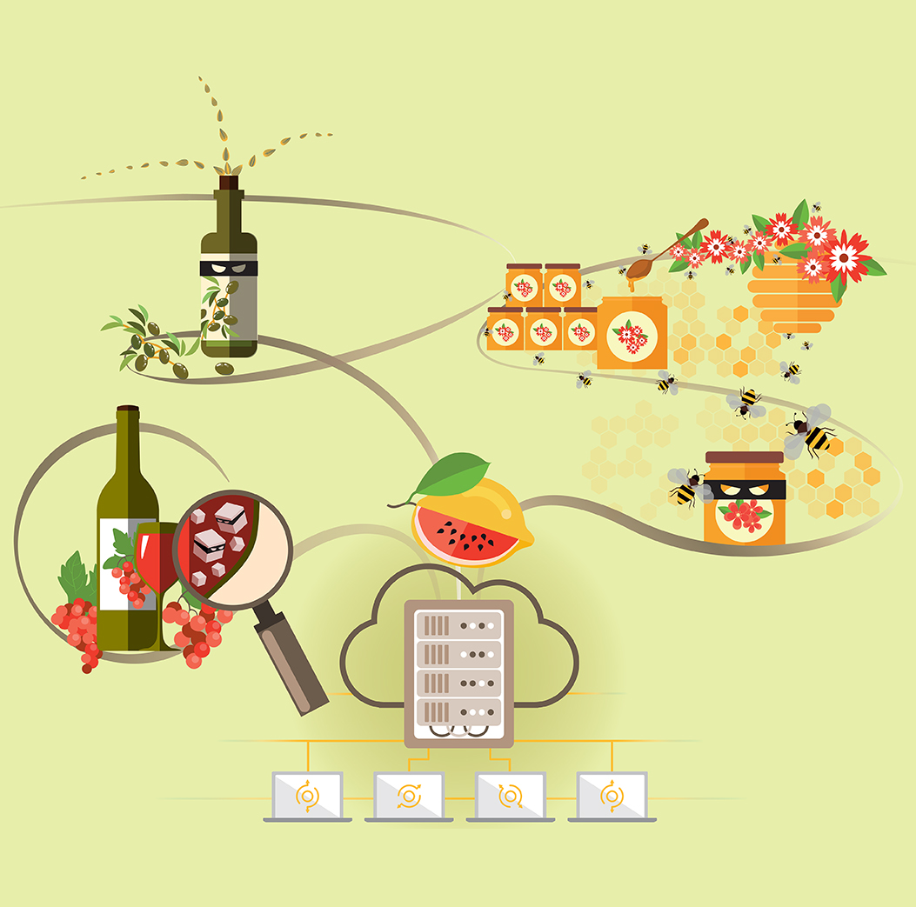
Knowledge Centres
Disaster Risk Management
Knowledge Centre
Knowledge
Centre on Migration and Demography
Knowledge Centre for Territorial
Policies
Knowledge Centre on Bioeconomy
Knowledge Centre for
Food Fraud
and Quality
Notes:
Some examples of the knowledge centres at the JRC
Knowledge Centres on 'Disaster Risk Management', 'Migration and Demography' and 'Territorial Policies' were started in 2016 – to date we have 7 knowledge centres in all (not listed here: AI watch/observatory, KC for Global Food and Nutrition Security)

Slide 13
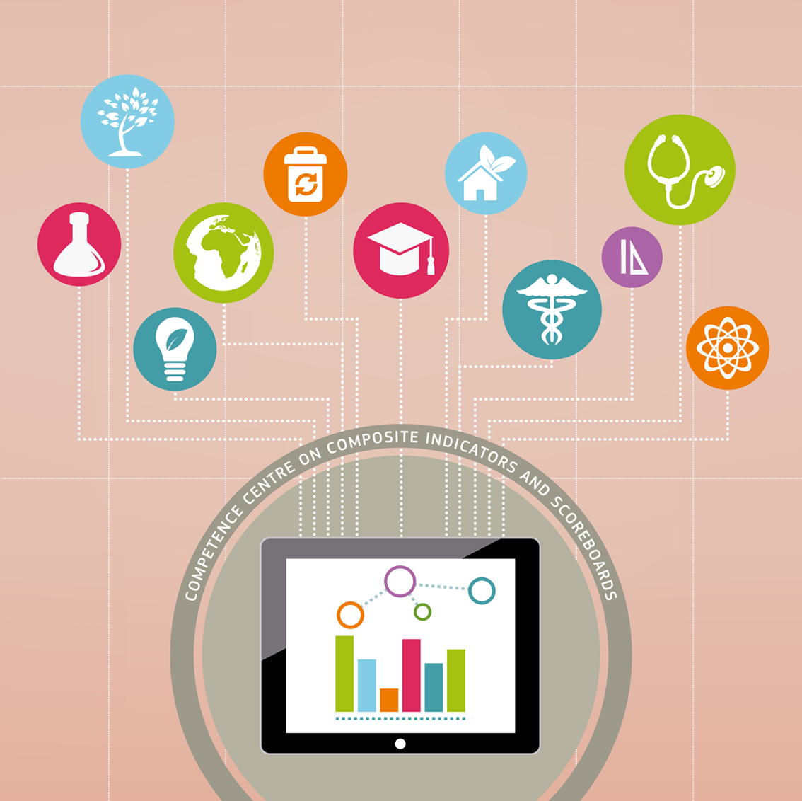


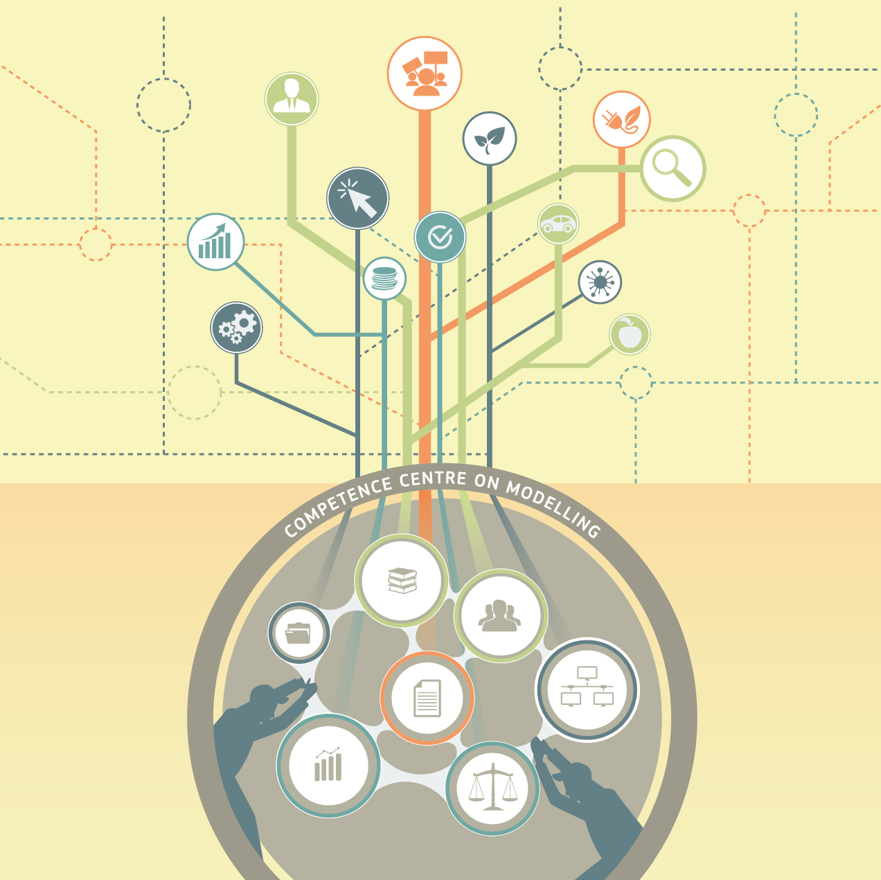

Competence Centres
Competence Centre on Composite Indicators and Scoreboards
Competence Centre on Microeconomic Evaluation
Competence Centre on Text Mining
and Analysis
Competence Centre on Modelling
Competence Centre on Foresight
Notes:
Competence Centres complement Knowledge Centres by focusing on analytical tools which can be applied to any policy area, and by bringing together in one place extensive expertise in this field. The Competence Centres 'Composite Indicators' 'Microeconomic Evaluation' and 'Text Mining and Analysis' have already been established while a Competence Centre ‘Modelling', is planned for launch in 2017. The latter will include an inventory of models used by the European Commission

Slide 14
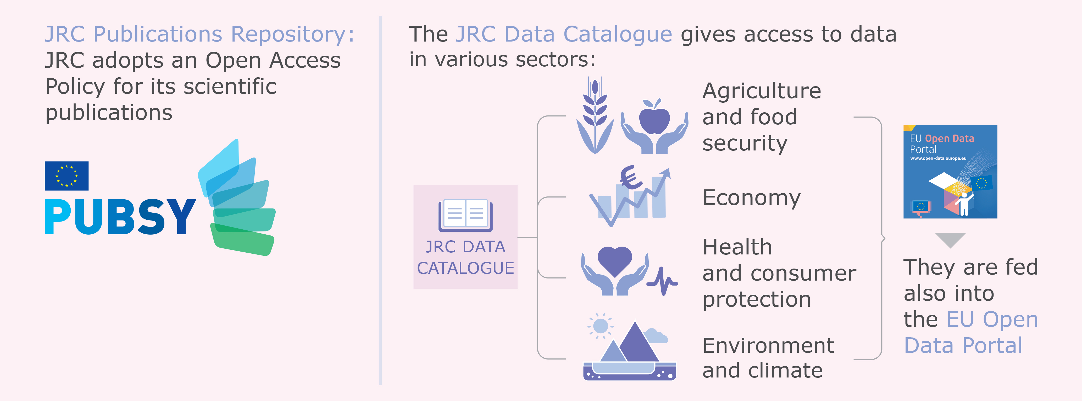
Data for Policy
Notes:
JRC has a long history of publishing on-line.
All JRC publications are open access and are found in our Publications Repository (accessible from the EU Science Hub)
Some 1400 publications are produced per annum of which 400 peer-reviewed.
The JRC Data Catalogue contains nearly 2600 data sets across a wide range of areas and is freely accessible, also feeds into EU Open Data Portal.
In addition, the JRC has more than 160 on-line databases all of which are searchable and accessible – can be found through EU Science Hub.

Slide 15
Knowledge 4 Policy Web Platform
A multi-community collaborative web platform designed to allow Commission knowledge services to:
effectively publish and manage (scientific) knowledge
for policymaking;
engage stakeholders in creating, curating, managing and using
that knowledge;
animate discussions and interactions;
create stakeholder communities
https://ec.europa.eu/knowledge4policy/
Notes:
The international nature of both science and politics means we cannot limit K4P to just the Commission’s scientists and policymakers — we need to organise scientific knowledge from across Europe, for policymakers across Europe.
All knowledge is in one single database, using a global taxonomy, so you need no longer search multiple sites to find relevant scientific knowledge for policymaking.

Slide 16
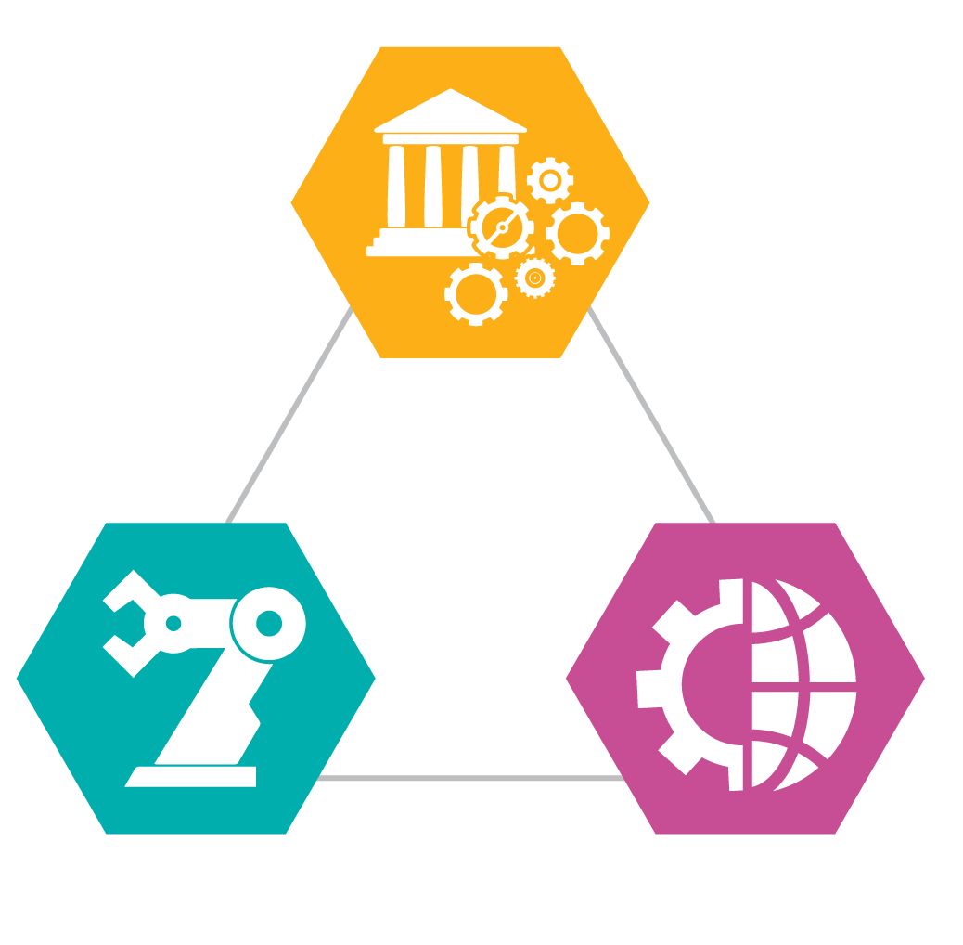
Living Labs at JRC
Evolving policy context of evidence and co-creation
Providing better evidence for policy & uptake
Facilitating transition to smart and sustainable cities
JRC site modernisation
The JRC can plug into existing LL
Notes:
Open Knowledge: EC Walks the Talk
We have already seen that the policy-evidence interface is complex and being the Commission's science and knowledge service has its own challenges.
We also realise that often barriers to uptake of policy can often be due to misperceptions and a lack of citizen involvement.
As part of our initiative to open JRC sites further, we are starting to pilot Living Labs on two of our sites – JRC Ispra in Italy and JRC Petten in the Netherlands.
We have a very strong focus

Slide 17

Living Labs at JRC: a showcase for smart & sustainable cities
Buildings
Security
Wellbeing
Energy
Mobility
Notes:
We have launched a pilot call on Living Labs in two areas:
Digital energy solutions
Future mobility solutions
Our sites offer:
A more controlled environment
Technology performance + user feedback
Involvement of users not just researchers
Complex real –life environment close to the real research setting, (bad weather, human errors)
Facilitates co-creation, co-design with all stakeholders
Our call is open until end 2020! Applications welcome!

Slide 18





    Stay in touch!
ec.europa.eu/jrc
@EU_ScienceHub
EU Science Hub - Joint Research Centre
Joint Research Centre
EU Science Hub

Slide 19
Thanks
Any questions?
Visit the European Commission website +
You can find me at: philippe.duponteil@ec.europa.eu

