Slide 1
Progressing Open Science together
EU Open Science coordination meeting
21 October 2019
Kostas Glinos, Head of Unit
DG RTD – Open Science
European Commission

Slide 2
Why do we need Open Science?
Open Science means sharing knowledge and tools as early as possible, not only between researchers and between disciplines, but also with society at large.
Open Science has the potential to increase:
  Quality and efficiency of R&I, if all the produced results are shared, made reusable, and if their reproducibility is improved;
  Creativity, through collective intelligence and cross-disciplinary research that does not require laborious data wrangling;
  Trust in the science system, engaging both researchers and citizens.

Slide 3
The example of Health R&I
Close to €300 billion/year for Health R&I (worldwide)
A large share of the research investment may be wasted: potentially as much as 85%, according to Chalmers & Glasziou 2009, Lancet; Macleod 2014, Lancet
  Unusable research reports
  - Methods and codes unavailable; Inadequate information on medical interventions in trials; etc.
  Scientific question not pertinent
  - Not relevant to clinicians, carers and patients; Lack of awareness of already existing evidences; etc.
  Biased reporting of results - Selective reporting; Data reported not made comparable with other studies; Conflicts of interest; Fraud; etc.
  Poor study design, conduct and analysis - Low statistical power; Not replicated enough; Not enough collaborative efforts; Poor training and mentoring of researchers; etc.
  Results not fully accessible
  - “Disappointing” results less likely to be promptly published (or at all); Trials not registered; etc.

Slide 4
Main challenges and priorities
Improve the practice of research and innovation
Freely accessible scientific publications
Early sharing of all research outputs
All data FAIR
Reproducible results
Societal engagement and responsibility
Develop proper enablers
Infrastructures (including EOSC)
A research system that rewards and incentivizes researchers to adopt Open Science practices, with appropriate metrics
Appropriate skills and education, including for research integrity

Slide 5
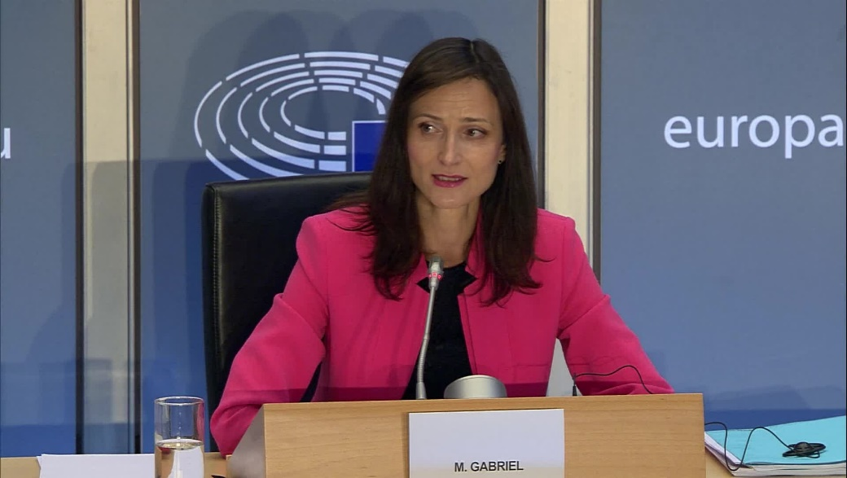
Commissioner-designate
Gabriel
Hearing in the European Parliament
30 September 2019
“The Open Science issue is […] an issue that is dear to my heart”
“Today, more than ever, we need researchers to share the results of their projects with others, and to capitalize on the research of others”
“I will insist on having data that are […] reusable, accessible, of quality”
“Today, we still have a lot to do. I think, for example, in the context of the European Research Area, how to encourage researchers who support open science, who support this […] by making efforts that others do not”
“There will be no strong European Union without our European citizens understanding, supporting and sharing our common goals”

Slide 6
Open Access
  OA to publications has been the cornerstone of EC policy since FP7, first as a pilot and in H2020 as a mandatory policy. A successful one (above 90% uptake).
  In H2020 we expanded to open access to research data, which, after a pilot is now mandatory with exceptions possible (as open as possible as closed as necessary).
  The EC has supported open access policies in MS through the recommendation on access to and preservation of scientific information (revised in 2018). Its implementation monitored through the national points of reference. New report to be released early 2020.
  Horizon Europe has new elements that empower researchers to provide open access to publications and to focus on responsible research data management with open access as the default.

Slide 7
Science & society
  Improving trust between science and society to maximise the benefits of their interactions
    Engaging and involving citizens and civil society in co-designing & co-creating responsible R&I agendas and contents
    Facilitating participation by citizens and civil society organisations in research activities
    Ensuring the integrity of research and cultivating a new ethos in science
  Horizon 2020 work programme 2018-2020 included:
    “Exploring and supporting citizen science”
    “Accelerating and catalysing processes of institutional change”, including research integrity
    “Building the territorial dimension of SwafS partnerships”
    “Building the knowledge base for SwafS”, including science communication

Slide 8
OS practice and research careers
Source: EUA, 2019 Open Science survey

Slide 9
Rewards and incentives
[From various expert group reports and position papers:]
Evaluation processes should give extra credits to individuals, groups and projects, that practice Open Science, based on appropriate indicators
  All evaluation steps at all stages of careers are concerned: from PhD thesis examination, recruitment, promotions, project proposal assessment, funding allocation systems, to prizes and recognitions, etc.
  In the evaluation processes, more emphasis needs to be put on the quality of the outputs, including on reproducibility of results.
The journal impact factors should not be used as a proxy for quality. Article-level and societal impact metrics should be developed and used.
There are already good practices that need to be collected and further exploited.
Incentives for life-long training on Open Science practices and research integrity are required.

Slide 10
Skills and education
[From various expert group reports and position papers:]
Open Science concepts and practice, together with data literacy, ethics and research integrity, should be an integral part of researcher’s education and career development
Principles and baseline skills should be integrated in, notably: the Innovative Doctoral Training Principles; the European Charter for researchers and Code of conduct for the recruitment of researchers; the Human Resources Strategy for Researchers
Training on Open Science needs to be designed and tailored for different disciplines and levels of researchers, but also for students and research managers and administrators
Life-long training needs to be incentivised, be resourced in a sustainable way and its impact be monitored
There are already good practices that need to be collected and further exploited.

Slide 11
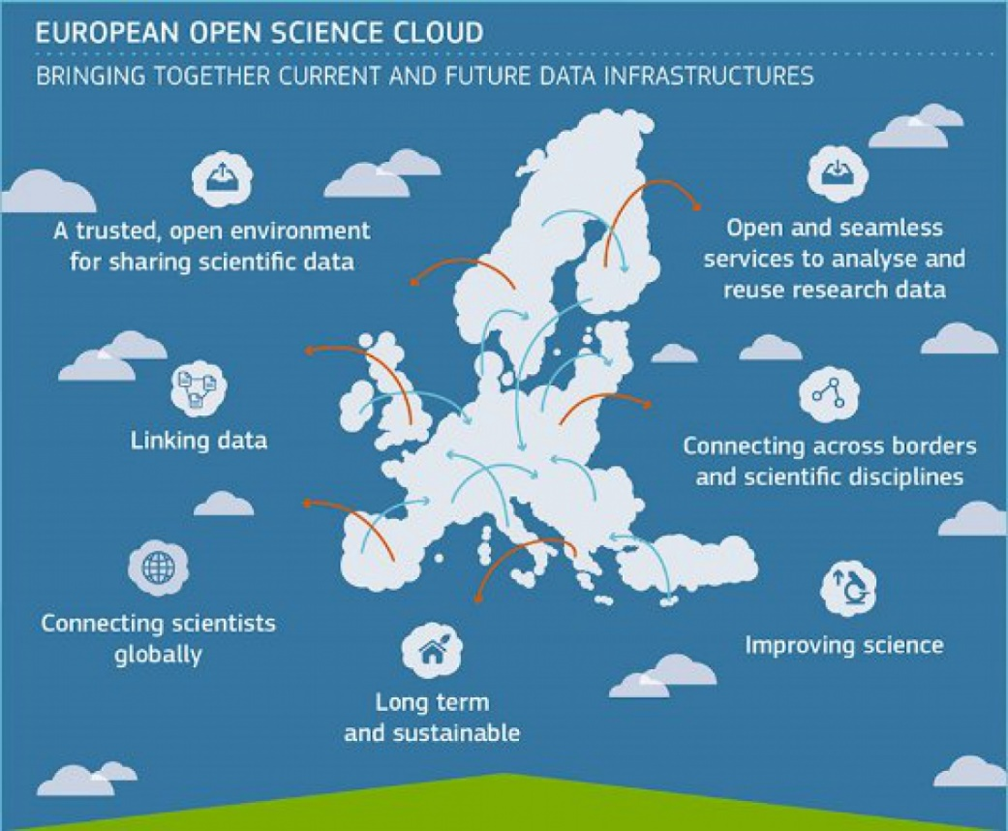
European Open Science Cloud
Enabling the digital transformation of research: data-intensive, collaborative and cross-discipline
EOSC will provide 2 million EU researchers and innovators an environment with services for data management, analysis and re-use across disciplines, increasing the creativity, productivity and reproducibility of research

Slide 12
How to move forward together?
Fully implementing Open Science practice requires:
  Engagement of all stakeholders: individual researchers, research performing organisations, funders, policy makers, learned societies, citizens, etc.
  At all levels: Regional, national, European and international
One policy, three sets of complementary actions:
  Develop the necessary infrastructures and services
  Induce and support coordinated system changes
  Walk the talk in European R&I programmes

Slide 13
Potential actions for system changes (1)
“Open Science coordinators” at national level, and “Open Science officers” at institutional level, would facilitate Open Science policy coherence and implementation, and learning from good practice
Monitor the implementation of the Commission recommendations on access to and preservation of scientific information, with the National Points of Reference, and incentivize good practice
Support the further development of infrastructures for Open Science, including EOSC
Open Science in a revitalised European Research Area (ERA), in synergy with the European Higher Education Area (EHEA)
Recognition of Open Science in regional R&I Smart Specialisation Strategies (RIS3s)

Slide 14
Potential actions for system changes (2)
  Support institutions including Universities and their alliances on the modernisation of research and researchers’ assessment, including by identifying, assessing and piloting the validity of metrics and quantitative/qualitative indicators
  Support policies and conditions (e.g. infrastructures) that enable open access as the default way of disseminating research (publications, data and other contributions)
  Develop a strong narrative for the role of Science in Society and promote specific actions, e.g. in science communication, science skills, rewarding engagement with citizens, research assessment pilots, promoting reproducibility, etc.
  Mainstream OS practices in thematic areas, e.g. FAIR data projects in specific domains

Slide 15
Leading by example in HE: Open Science as a modus operandi
Reinforce the mandate for open access to publications and data (also through the Open Research Europe publishing platform)
Mandate research data management in line with FAIR data principles, and promote long-term preservation
Develop the underpinning European Research Infrastructures and EOSC
Encourage transdisciplinary and inter-sectoral approaches that include civil society organisations, citizens and end-users
Mainstream citizen science and user-led innovation across the programme
Promote innovative and effective two-way science communication
Through Model Grant Agreement, evaluation of proposals, funding of infrastructure, broad notion of integrity, project reviews, …

